Slide 1
Can mining be inclusive?
Social conflict, institutional change and the governance of extraction
Anthony Bebbington
Graduate School of Geography
Clark University
(Denise Bebbington, Mari Burneo, Jeff Bury, Anahi Chaparro, Guido Cortez, Nick Cuba, Silvia Passuni, John Rogan, Martin Scurrah)

Slide 2
Reflections on inclusion
Can mining be inclusive? ….. yes, of course ….
Modes of inclusion:
  Labour
  (Co-)Ownership
  Suppy-chain management
  CSR
  “Corporate Community Development”
  Consultations
  Tax royalties and the finance of social investment
    Poverty reduction in Peru and Bolivia

Slide 3
Reframe the question…..
How inclusive and in what ways?
Do exclusions accompany the inclusions?
  Can accompanying exclusions be offset without affecting the inclusions?
  Do such exclusions risk de-legitimizing the inclusions?
  What does this mix of inclusions and exclusions imply for the quality of “development” and “democracy”?
Is inclusion only a matter of assets and flows?
  Or also of ideas, discourses, values, logics of calculation?
Are the inclusions events, or on-going processes?
Implications of the inclusions/exclusions?
  Explaining conflict: Peru, El Salvador
  Is mining inadequately inclusive for population and sector alike?
How do institutions of inclusion emerge?

Slide 4
Outline
The extractive boom and its drivers
New geographies of extractive industry in Latin America
Localized exclusions and inclusions: risk, dispossession, opportunity
Mobilizations, exclusions and (more?) inclusion?

Slide 5
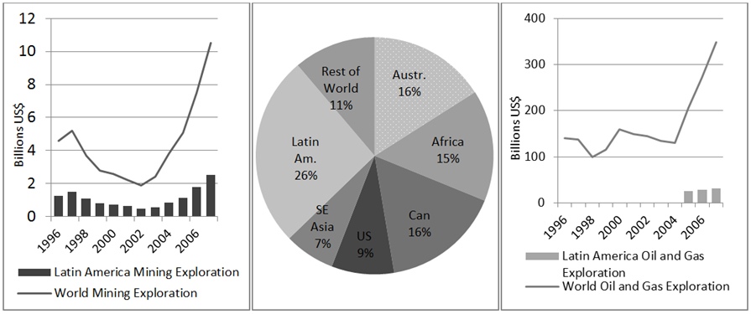
The extractive boom and its drivers
Notes:
Mining and Hydrocarbons Exploration Trends 1996-2007 (left-mining; middle-world mining exploration average by percent; right-oil and gas exploration). (Sources: Barclays 2009; 2011; Ernst & Young 2010; IFP 2011; MEG 2011)

Slide 6
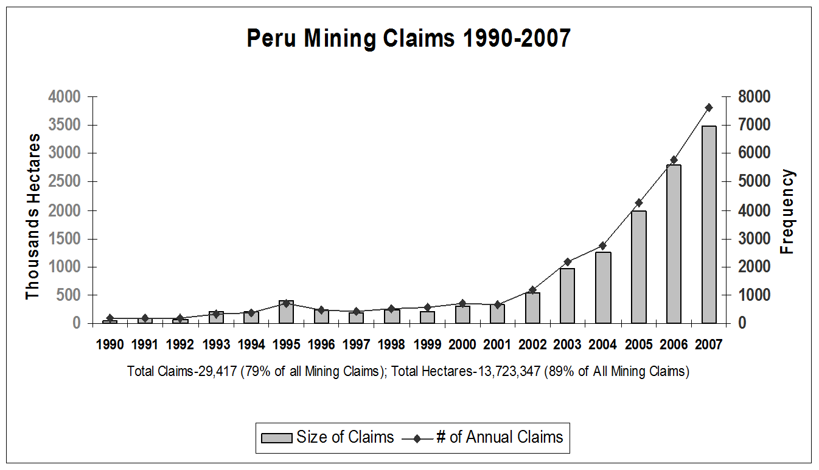

Slide 7
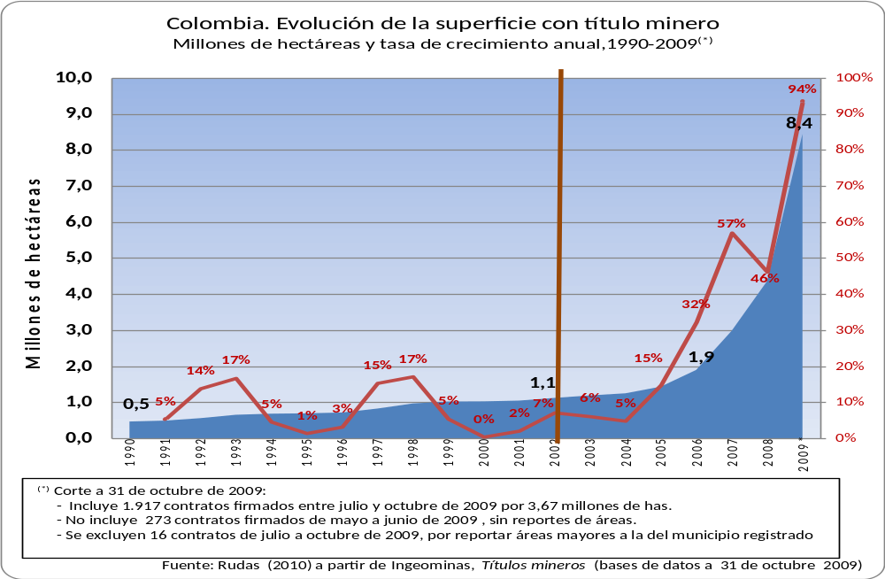
Colombia: Mining Claims

Slide 8
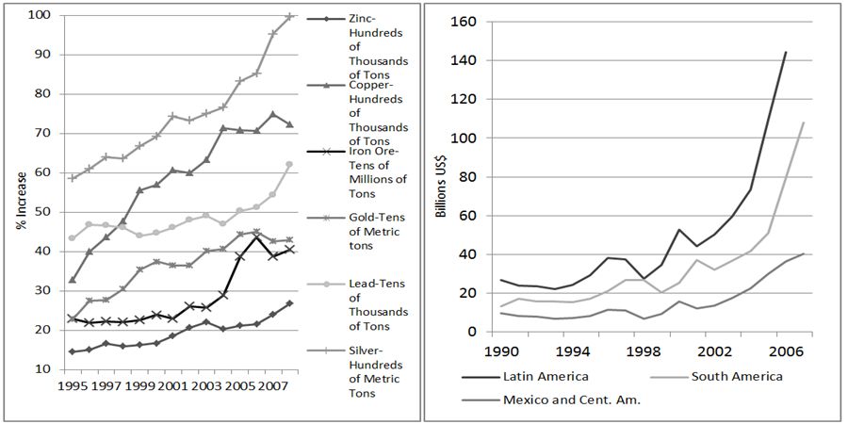
Notes:
the rates of extractión for nearly every mineral resource since 1995 (Figure 2.15).
Mineral exports have also grown across the entire region, particularly in South America, increasing by US$123 billión between 1990 and 2006

Slide 9
Frontiers, new and old
A rapid and expansive commodification of the subsoil (Polanyi…..)
Factors driving expansion
    Price and demand (emerging economies)
    Technological change
    Regional integration (trade agreements, energy, IIRSA)
    New sources of investment (emerging economies)
    Policy reforms (“Exogenous” and “Endogenous” actors)
    National political projects

Slide 10
  “necessity obliges us to exploit this natural resource, the gas, the oil, for all Bolivians…. If there’s oil, gas, you know it is for all Bolivians and this money that we collect from oil, from gas, has to go to all Bolivians”(Morales, 2009).
Bolivia
“What, then, is Bolivia going to live off if some NGOs say ‘Amazonia without oil’? ….They are saying, in other words, that the Bolivian people ought not have money, that there should be neither IDH [a direct tax on hydrocarbons used to fund government investments] nor royalties, and also that there should be no Juancito Pinto, Renta Dignidad nor Juana Azurduy [cash transfer and social programs].” (Morales, 10-7-2009)
  “Is it mandatory to get gas and oil from the Amazonian north of La Paz? Yes. Why? Because … combined with the right of a people to the land is the right of the state, of the state led by the indigenous-popular and campesino movement, to superimpose the greater collective interest of all the peoples.” (Garcia Linera, 11-9-9)

Slide 11
“The ecologists are extorsionists. It is not the communities that are protesting, just a small group of terrorists. People from the Amazon support us. It’s romantic environmentalists and those infantile leftists who want to destabilize government.” (Correa, 2-12-07)
Ecuador
“I’ll say it again, with the law in my hand, we will not allow such abuse, we will not allow uprisings that block roads, that attack private property ..… we will not allow this abuse, we will not allow uprisings that block roads, that compromise private property..… It’s absurd to be sitting on top of hundreds of thousands of millions of dollars, and to say no to mining because of romanticisms, stories, obsessions, or who knows what” (Correa, 10-2008)
“If that is how it is going to be, keep your money and in June we’ll begin to exploit ITT. Here we are not going to trade in our sovereignty” (Correa, 11-1-2010)

Slide 12
Colombia
National Development Plan, 2010-2014
The five locomotoras:
  Mining (leading sector: 54% of all private investment, 41% of public inv. for growth)
  Infrastructure
  Housing
  Rural development (2% of planned investment)
  Innovation

Slide 13
“Neo-liberal” and “Post-neo-liberal” regimes: important differences, intriguing convergences
  Governments promoting extraction
  Fiscal imperatives
  Criticism of movements, activists and allies … authoritarian tendencies
National-mass political projects trump territorial-environmental projects
National inclusions, localized exclusions?

Slide 14
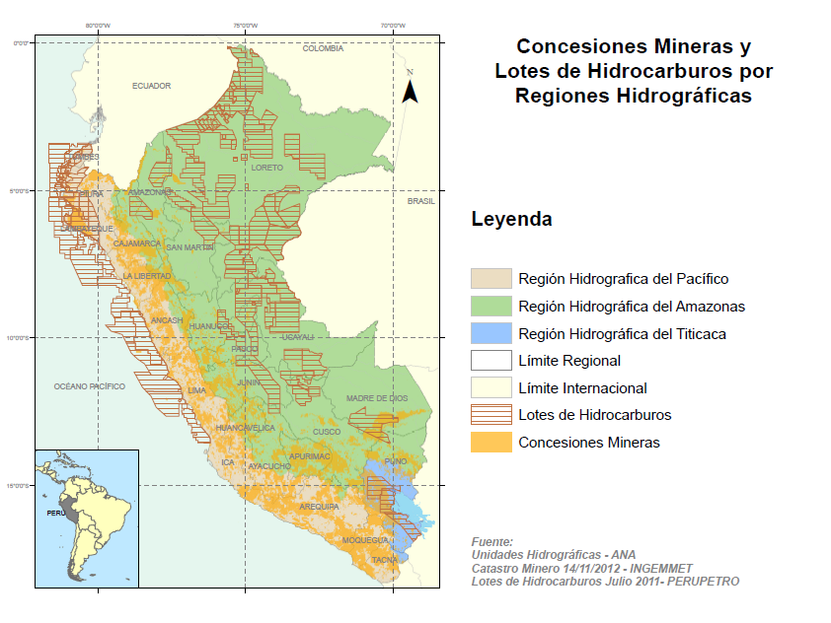
New geographies of extractive industry in Latin America

Slide 15
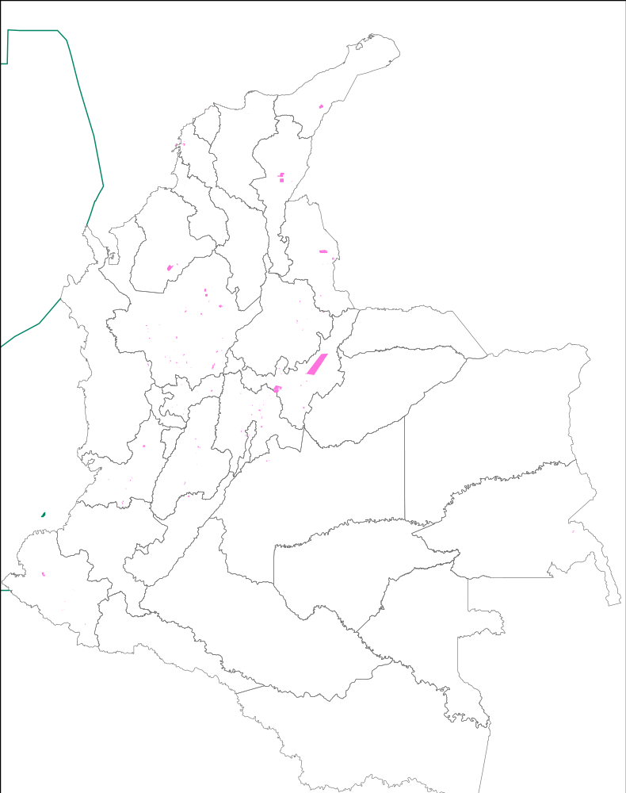
Colombia: mining titles 1990-2009
1990
467 Thousand hectares
Source: Instituto Colombiano de Geología y Minería – Ingeominas (Rudas, 2011)

Slide 16
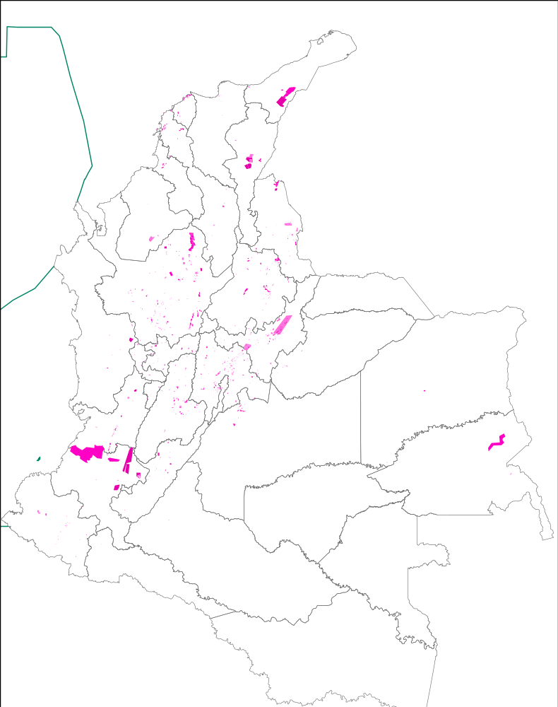
1994-1998
Samper
654 + 172 =
826 thousand hectares
Source: Instituto Colombiano de Geología y Minería - Ingeominas

Slide 17
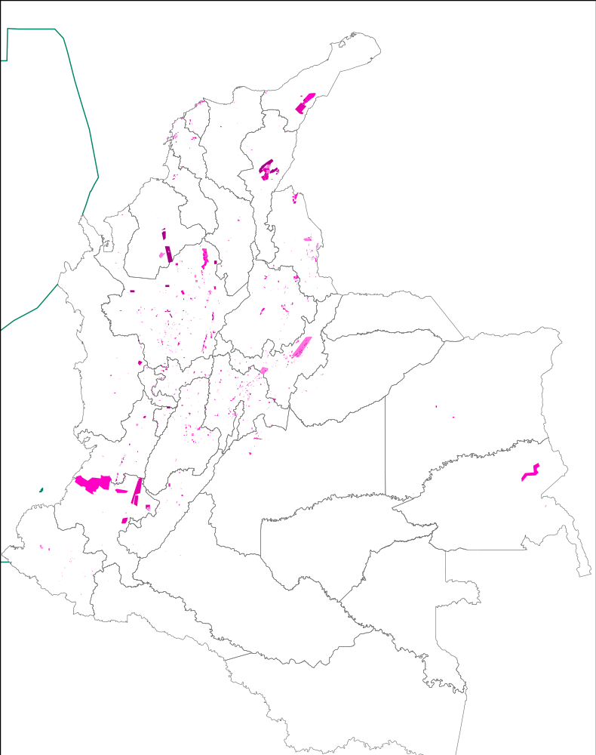
1998-2002
Pastrana
1.047 thousand hectares
Source: Instituto Colombiano de Geología y Minería – Ingeominas (Rudas, 2011)

Slide 18
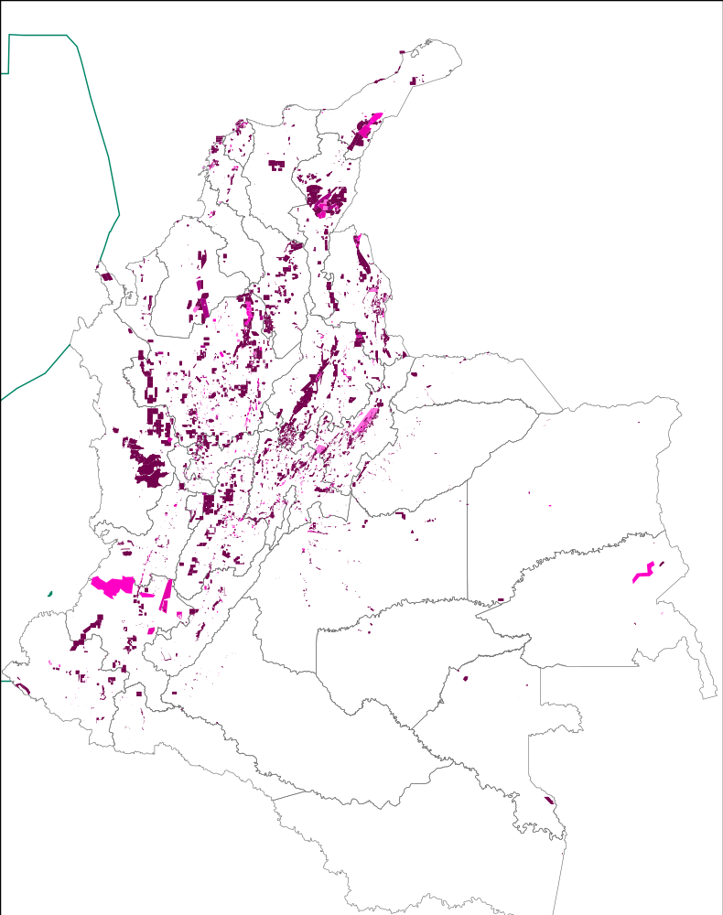
2002-2009
Uribe
1.047 + 3.724
= 4.771 thousand hectares
4.771 + 3.673 (Jul-Oct 2009)
= 8.444 mil hectáreas
Source: Instituto Colombiano de Geología y Minería – Ingeominas (Rudas, 2011)

Slide 19
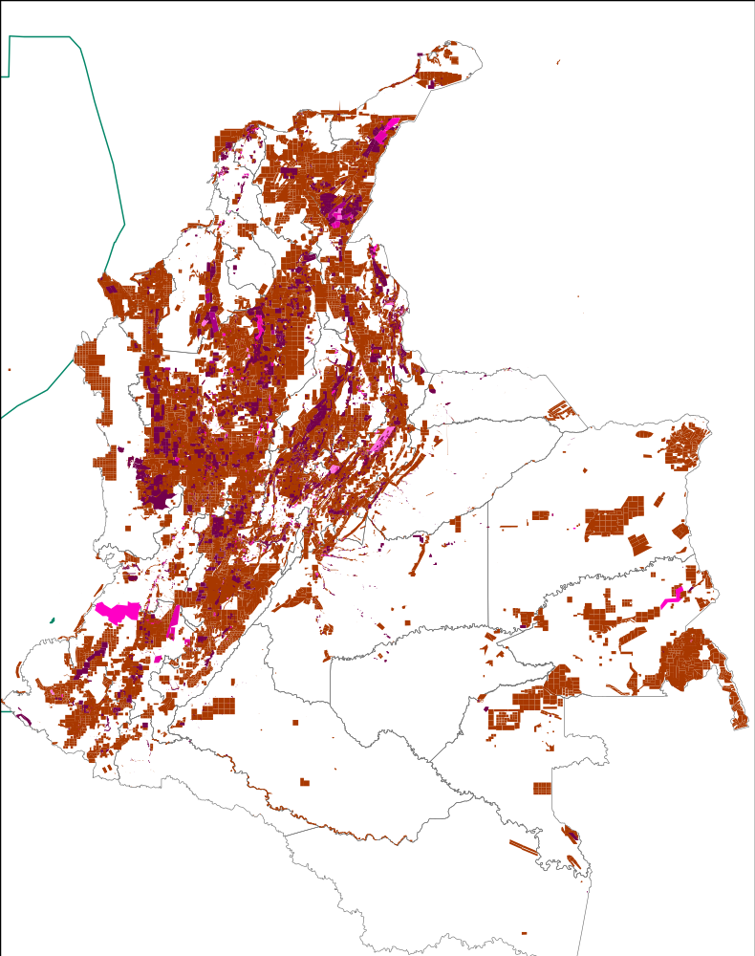
2009
Uribe
Titles and requests for mining title
Source: Instituto Colombiano de Geología y Minería – Ingeominas (Rudas, 2011)

Slide 20
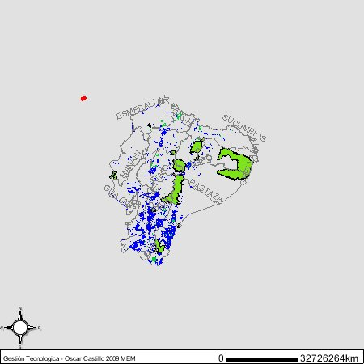
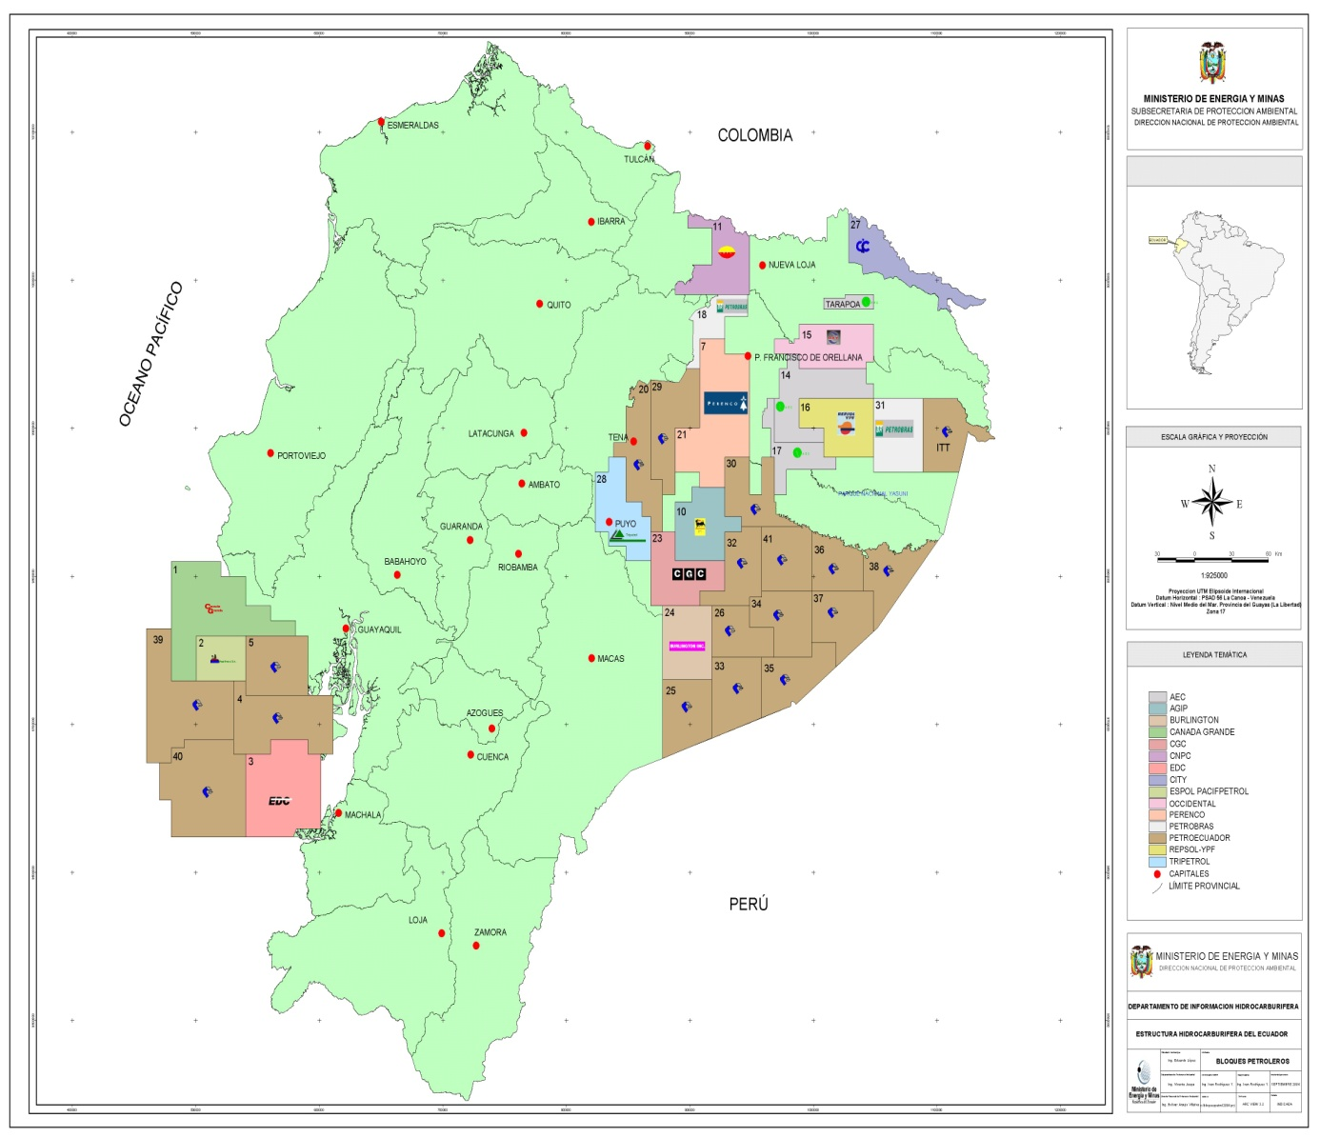
Geographies of mining (left) and hydrocarbon (right) concessions in Ecuador

Slide 21
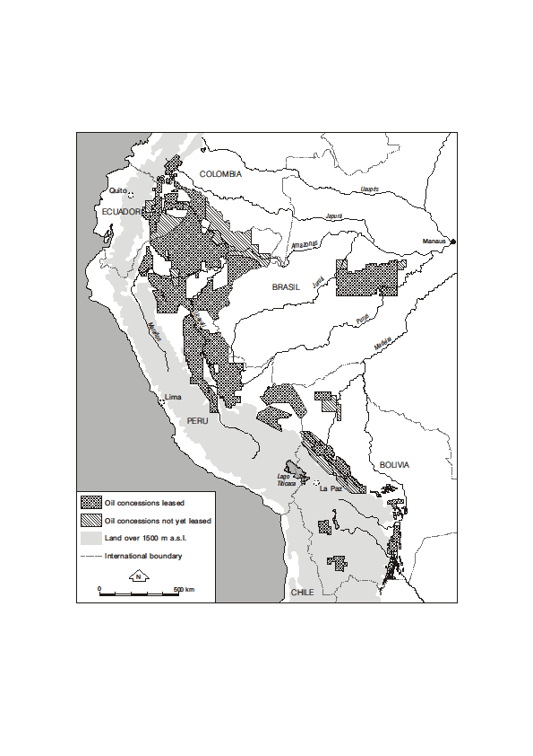
Based on: Finer et al. (2008) and YPFB (s.f.)
Hydrocarbons concessions, Andes and Amazon

Slide 22
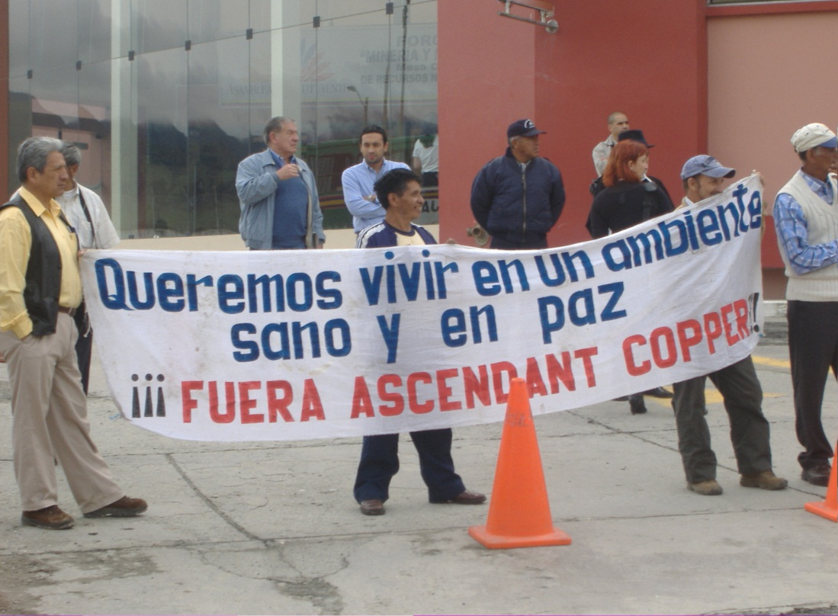
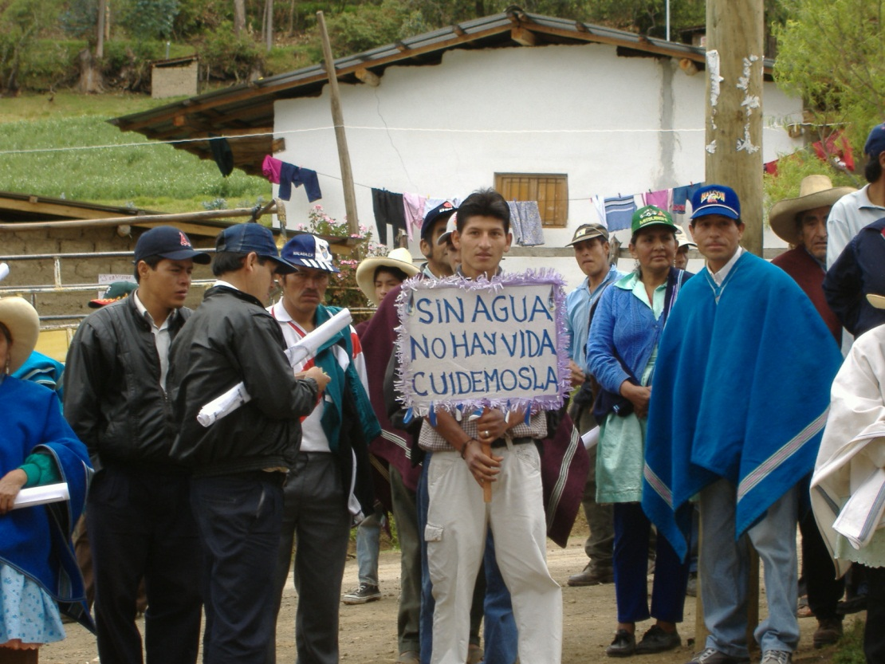
Localized exclusions and inclusions
Risk/uncertainty
concessions as (unconsulted) cartographies of uncertainty

Slide 23
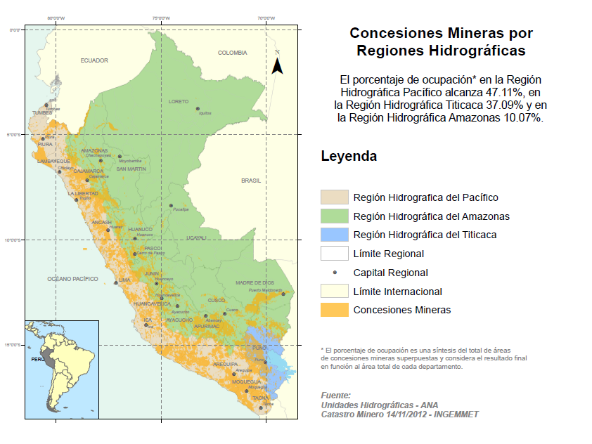

Slide 24
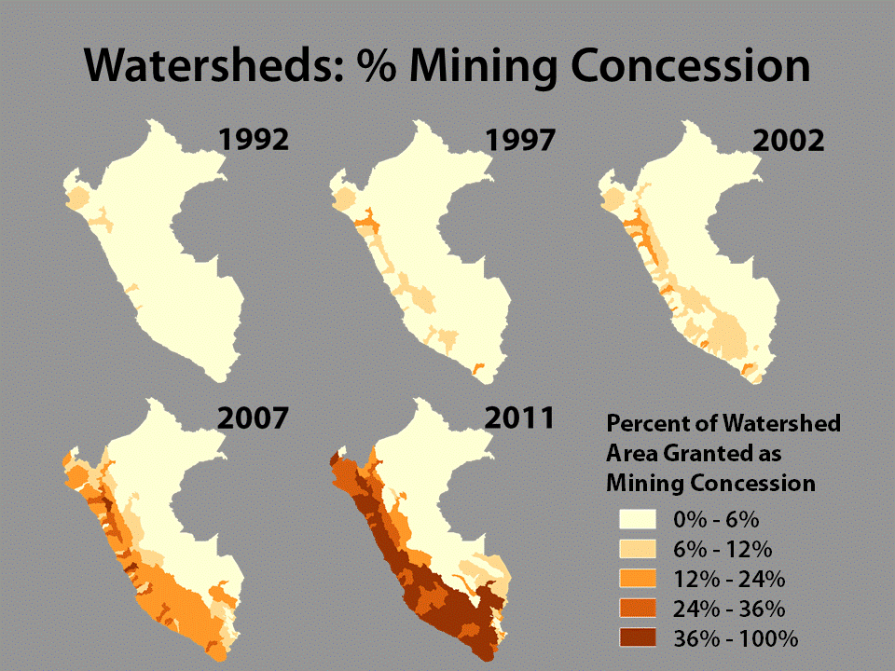
Notes:
Figure 2.2 National maps of the percent area of each watershed granted as mining concession. The highest values are spatially clustered in highland and coastal areas, and increase most rapidly during the mid- to late- 2000s.

Slide 25
Notes:
Figure 2.3 Temporal profiles showing change in percent of total watershed extent granted as mining concessions, and change in number of mining concessions per watershed, for the five watersheds with the greatest area under mining concessión (through 11/16/2011).

Slide 26
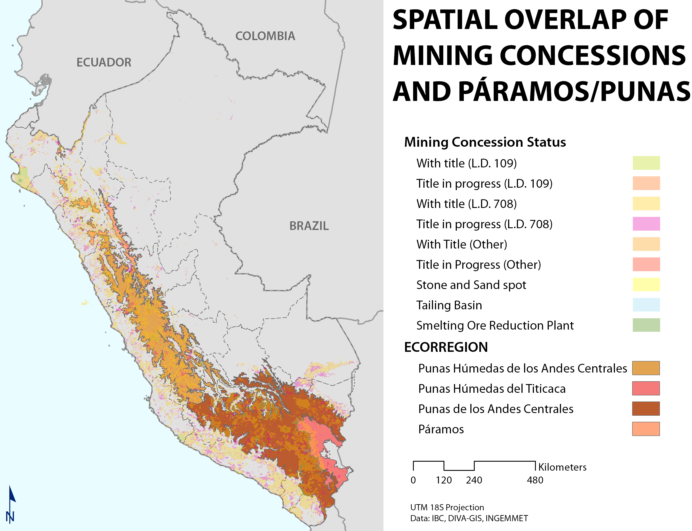
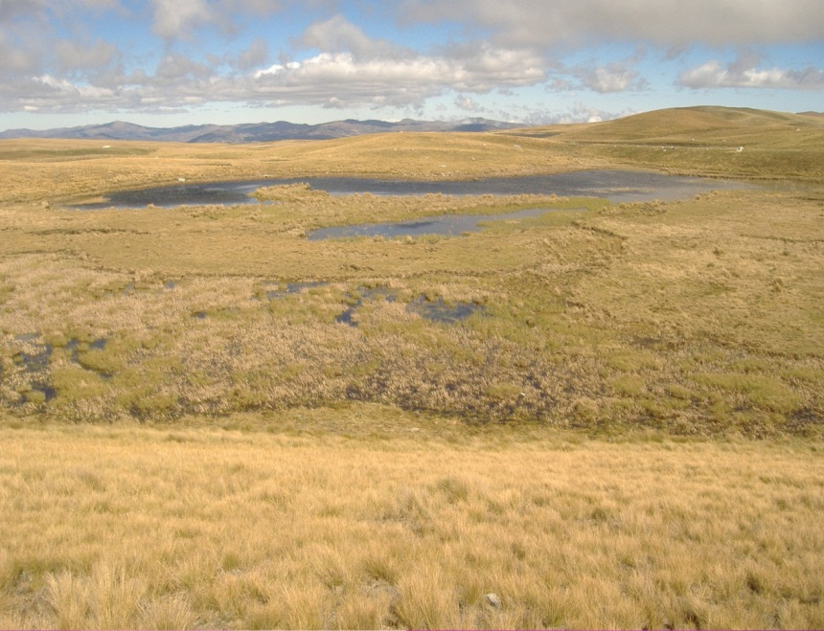
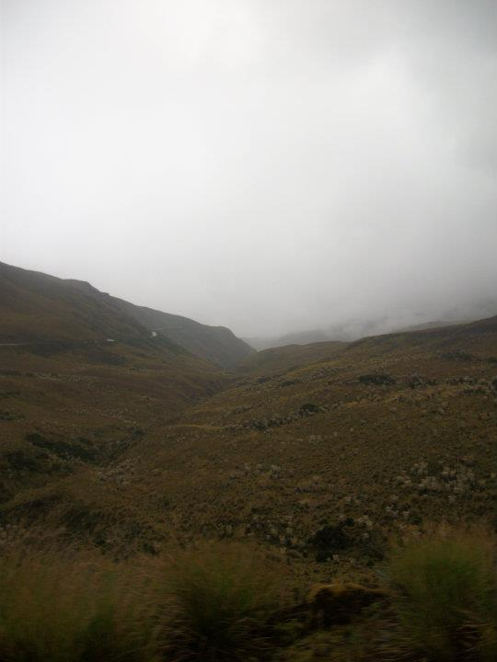
Notes:
Figure 8.1 Spatial configuratión of mining concessions and Paramos and Punas ecoregions (CDC) in Perú. oncessions are shown with a 67% transparency to highlight locatión of Humedales.

Slide 27
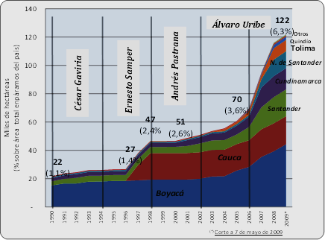
Mining titles in the Colombian paramo

Slide 28
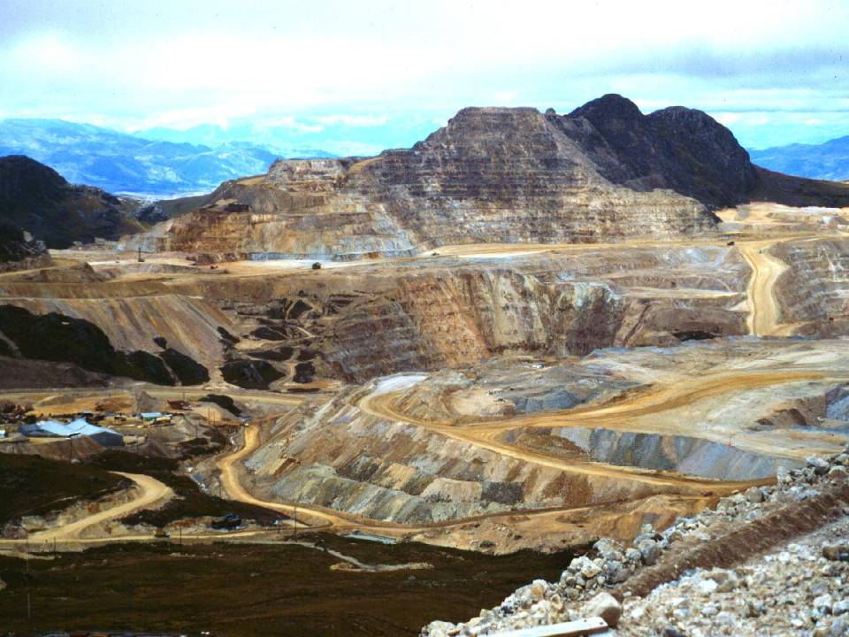
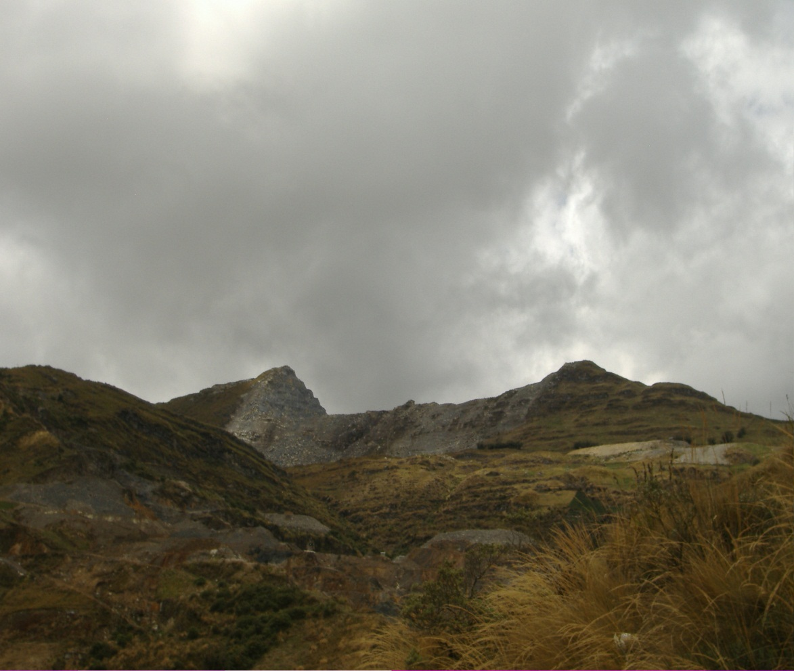
Dispossessions

Slide 29
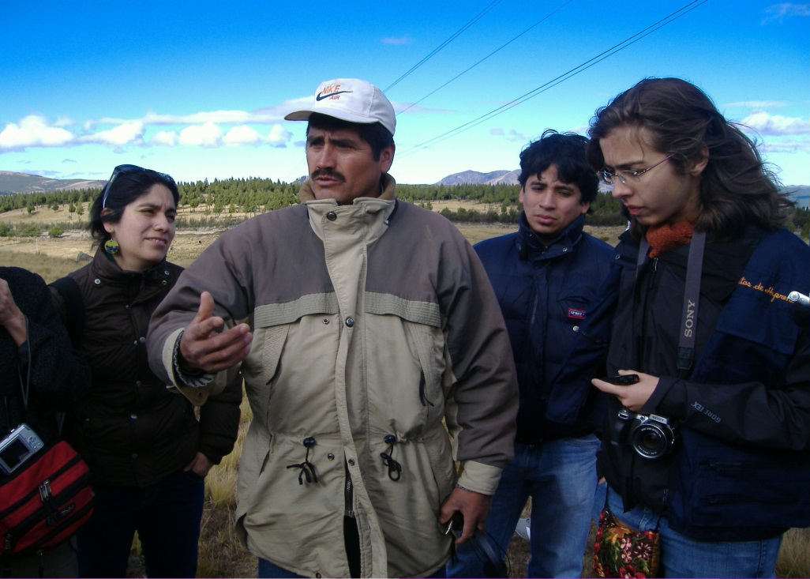
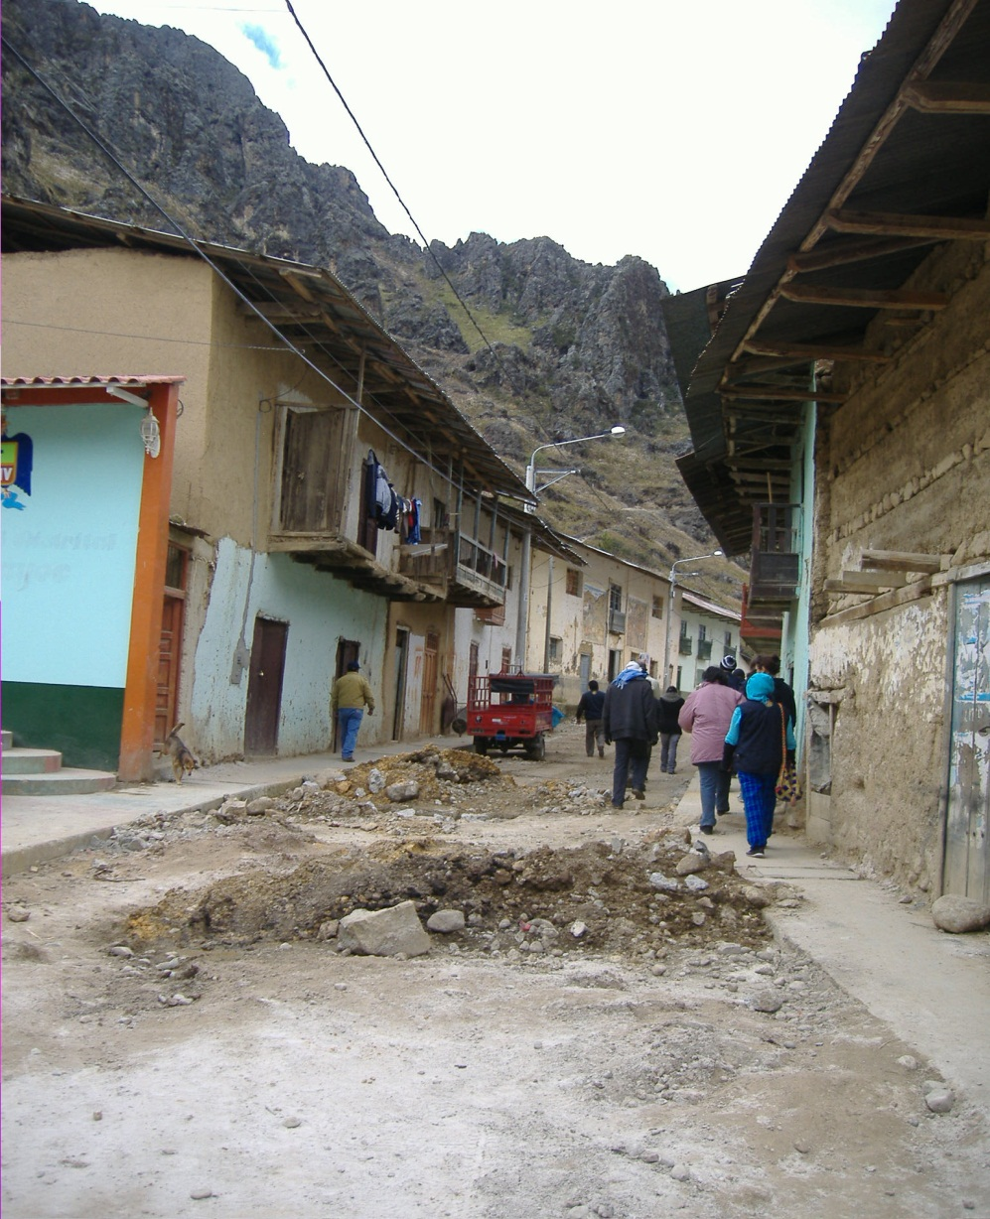
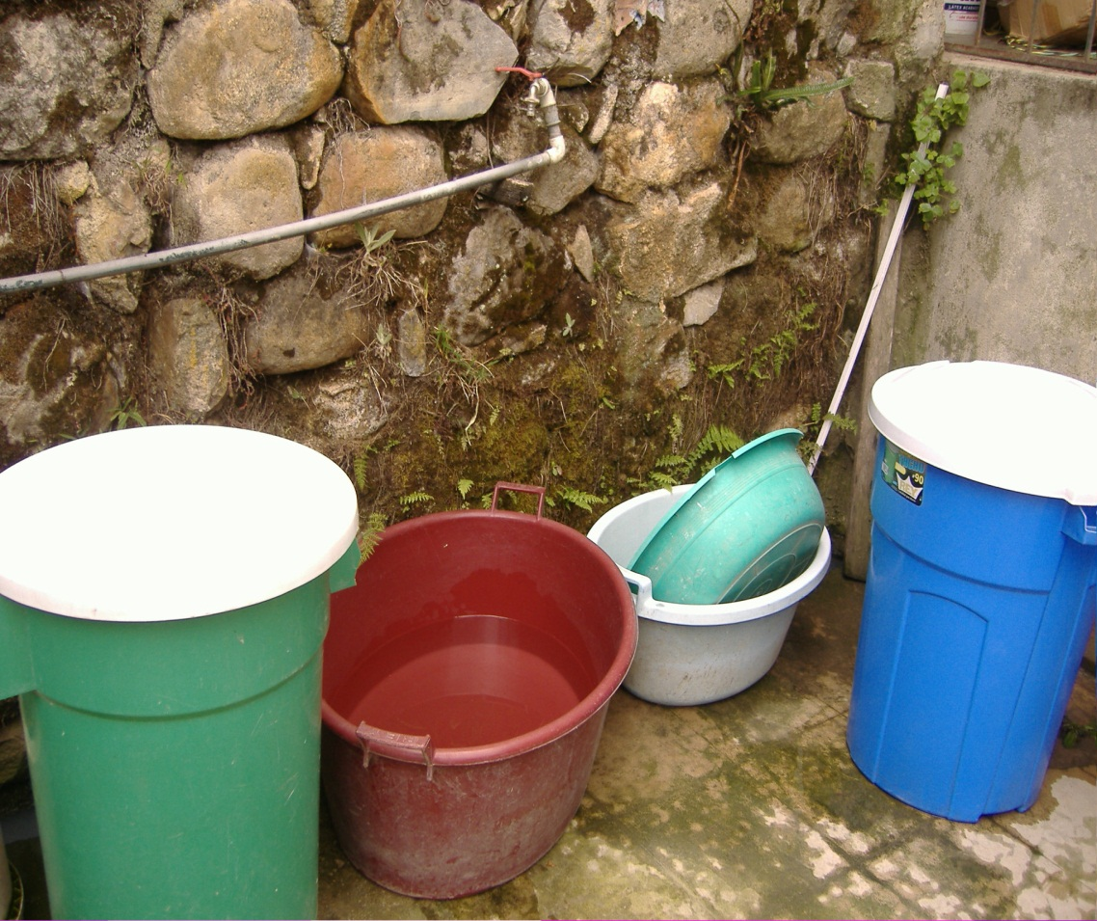

Slide 30
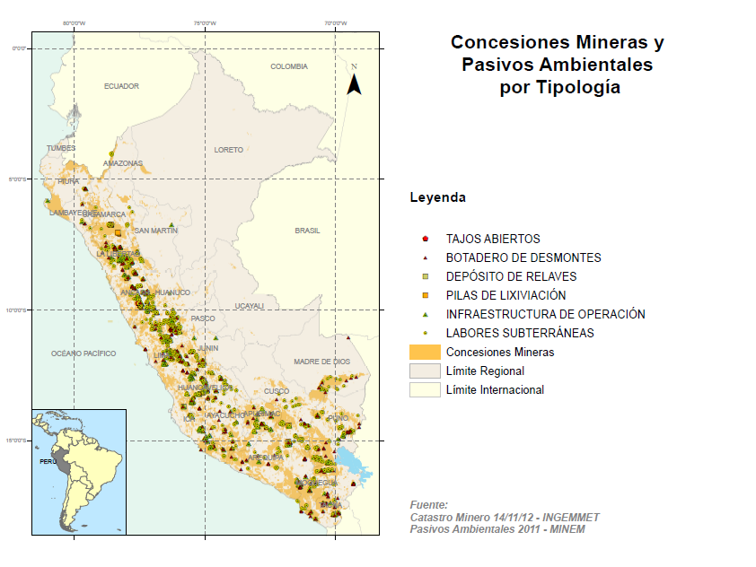
Environmental liabilities
(intergenerational exclusions)

Slide 31
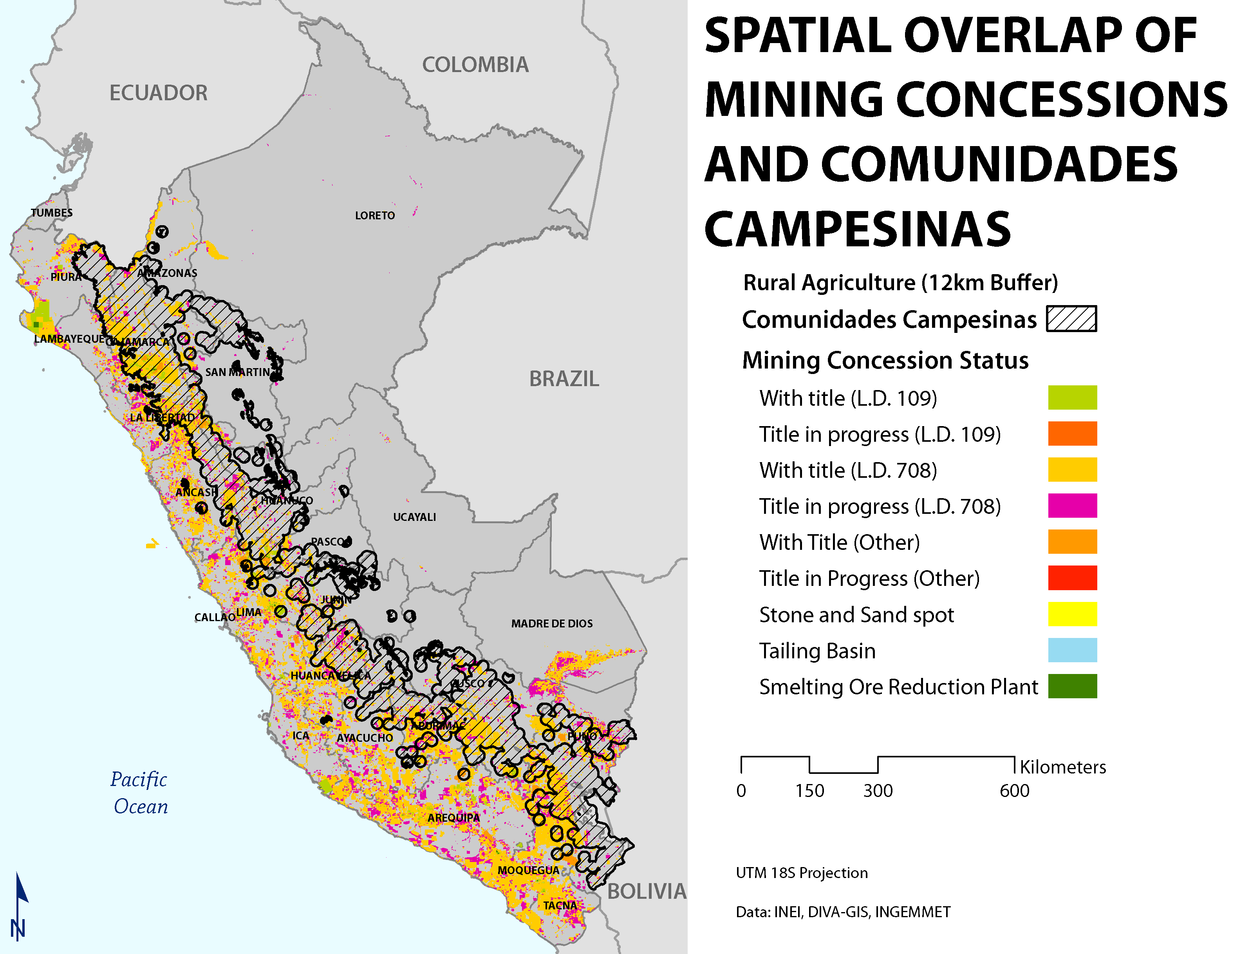
Notes:
Figure 6.2. Spatial configuratión of mining concessions and Rural Agricultural Communities in Perú. Locations of rural agriculture were derived from Perú populated centers (2007, INEI) according to the following rules:
Rule 1: 200 < Populatión < 2000
Rule 2: Category Type relating to Agriculture (e.g. Cooperativa Agraria, Caserio, Unidad Agropecuaria)
Rule 3: Populated Center must be in highlands región (CDC)
Buffer of 12 km used, final extent clipped by highlands región (CDC)

Slide 32
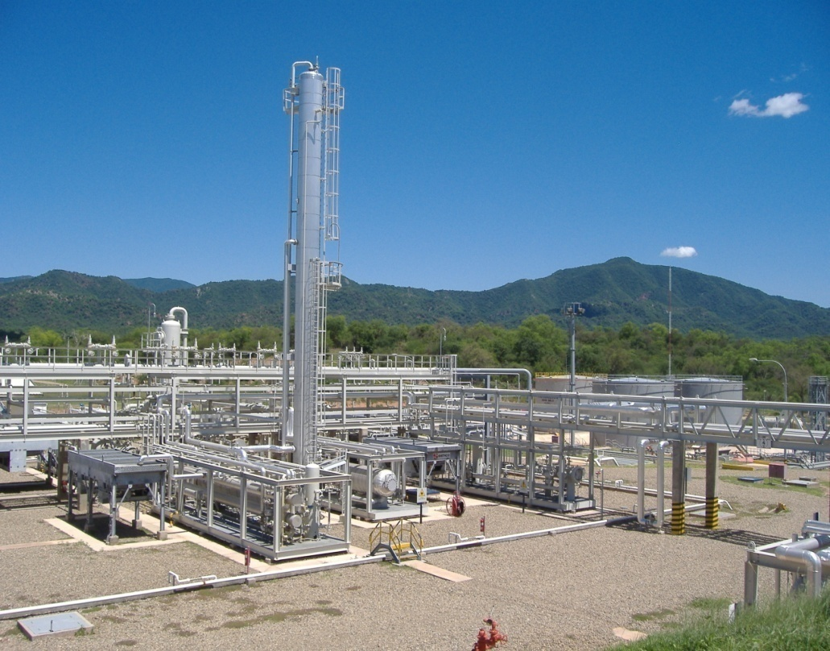
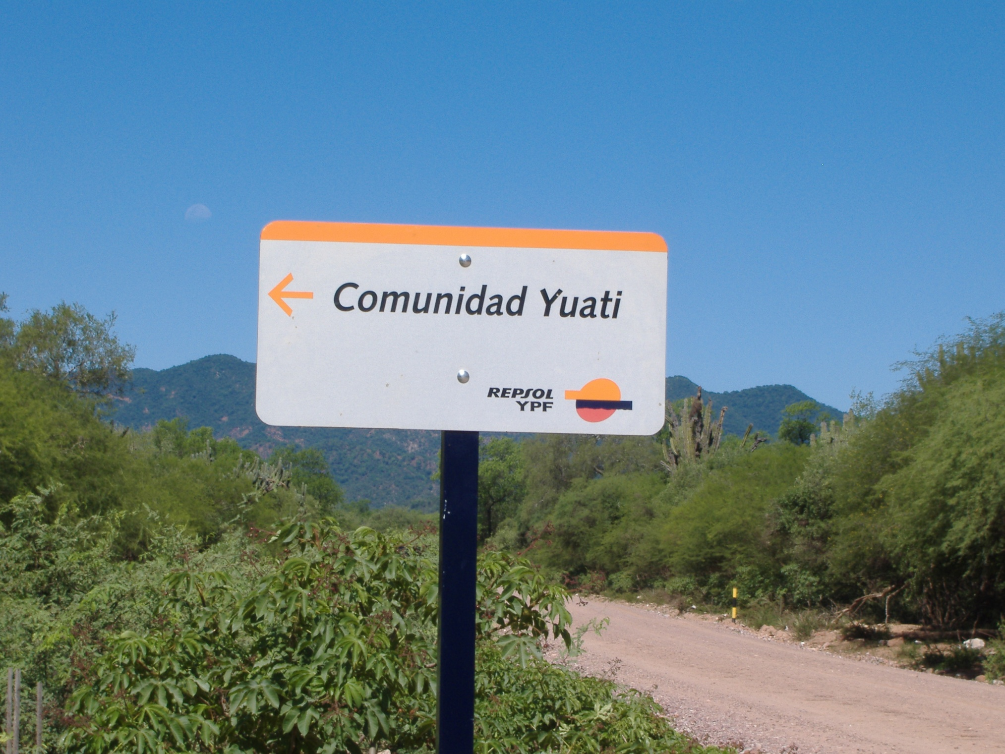
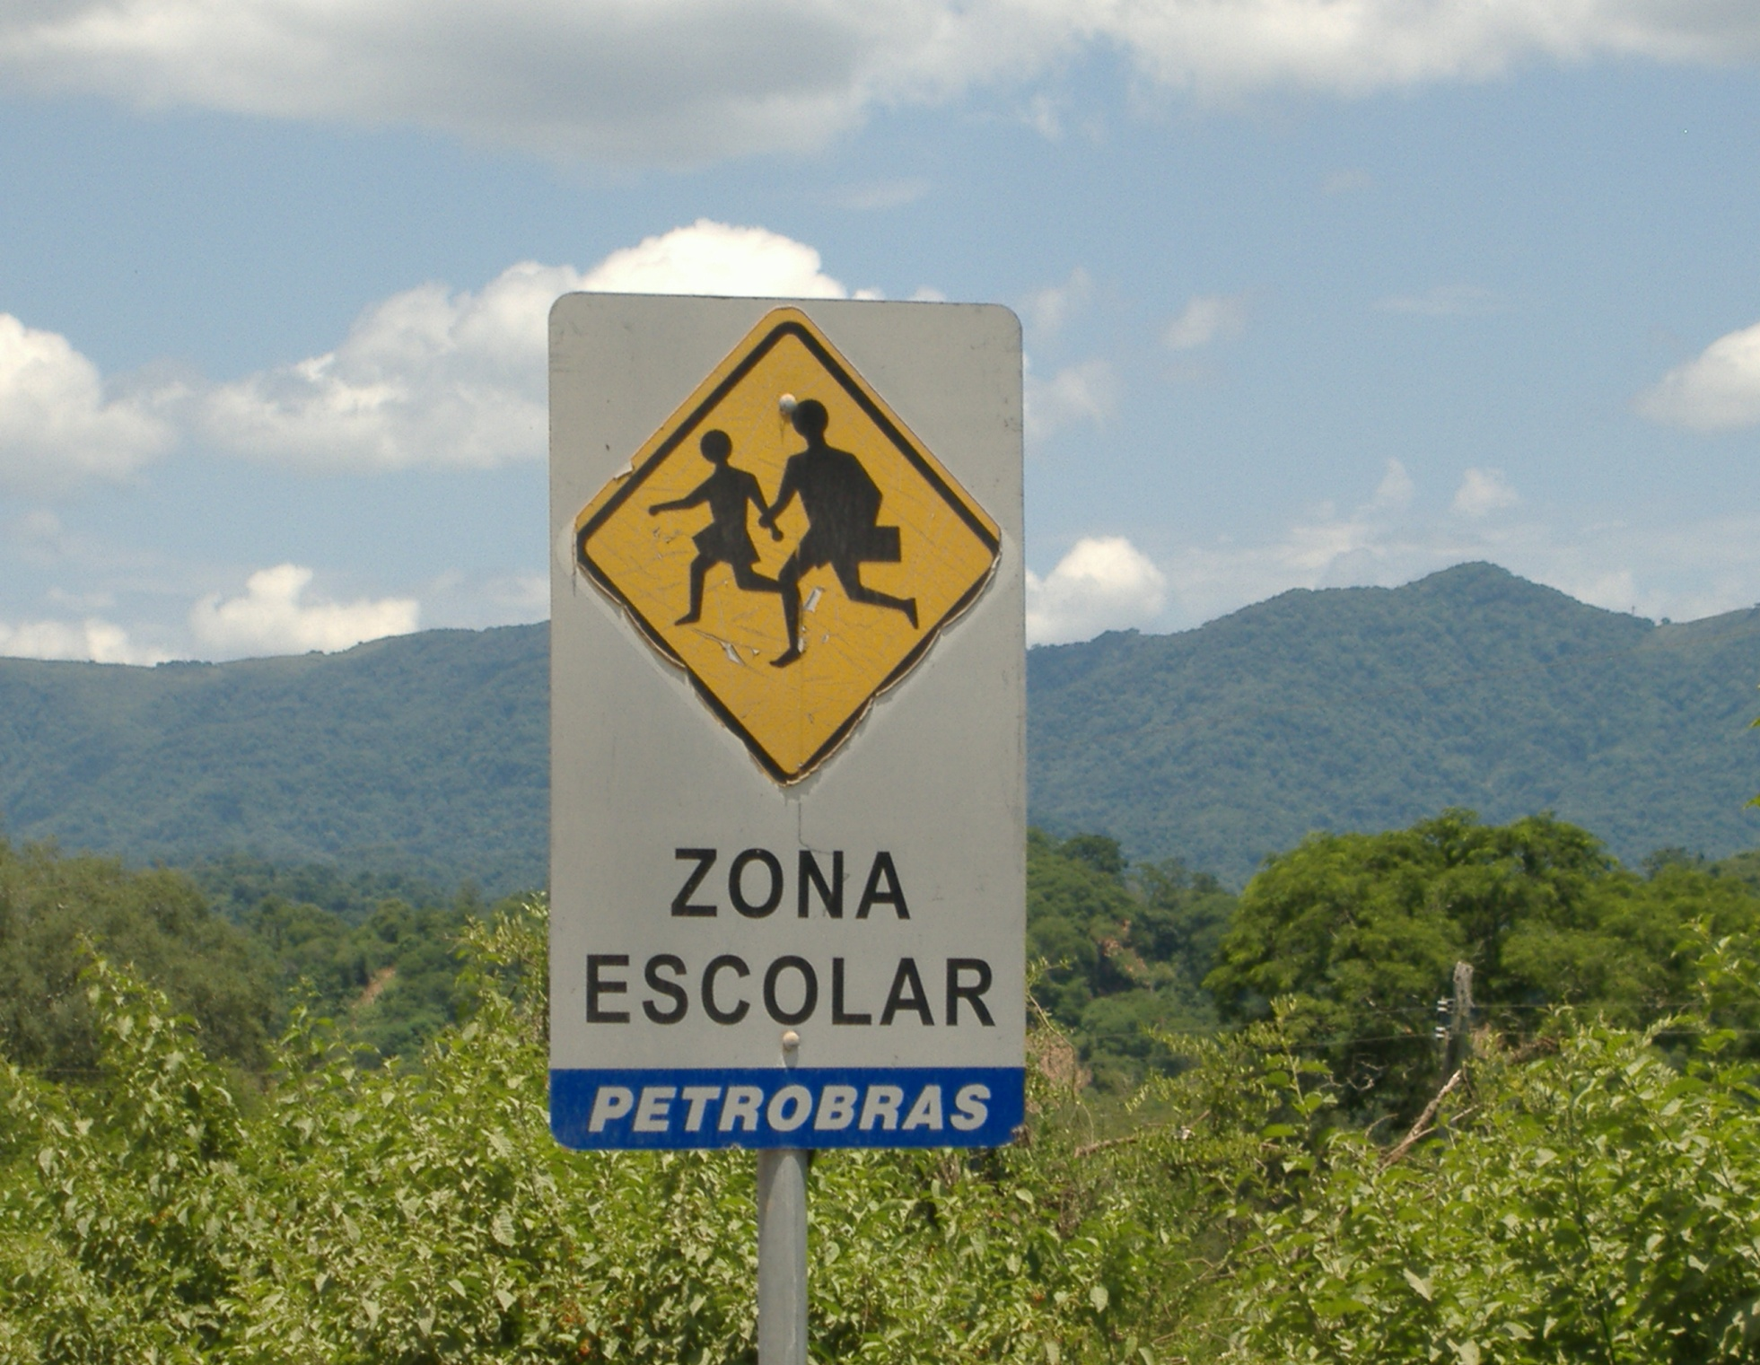

Slide 33
Los Negritos, Cajamarca, Peru (Kamphuis, 2010)
1993, 609.44 ha. of Negritos land expropriated for Yanacocha
  $ 30,000
1995, 800.10 ha of Negritos land subject to easement requested by Yanacocha
  $ 18,000
1993, Yanacocha mortgages expropriated land
  $ 50,000,000
1994, Yanacocha obtains a second mortgage over same land
  $ 35,000,000

Slide 34
Strategies for securing dispossession
Discursive
  “Peru, país minero” “Bolivia, país minero” “Ecuador, país soberano”
  Agriculture, inefficient user of water; mines, producers of water
  “Development,” “modern mining, “primitive communities”
Legislative
Social responsibility programmes and compensation
Markets
Intimidation and violence

Slide 35
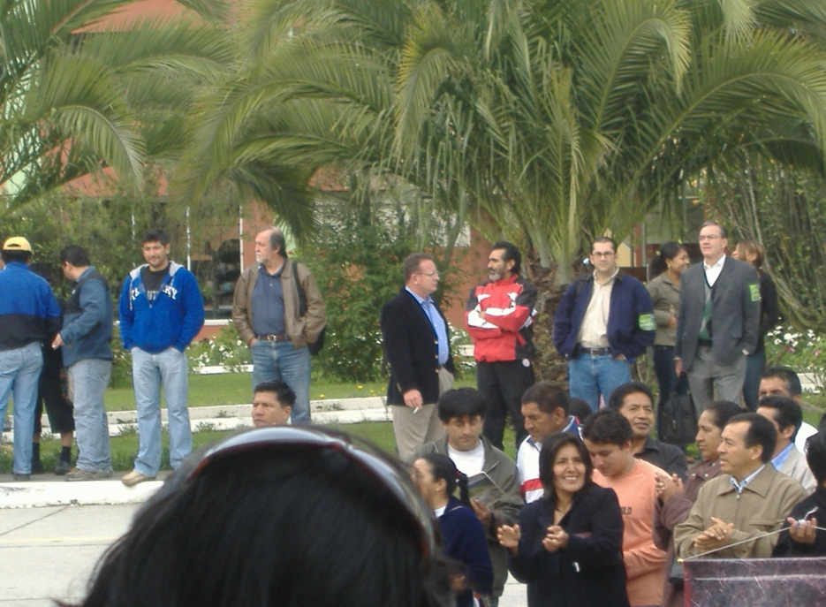
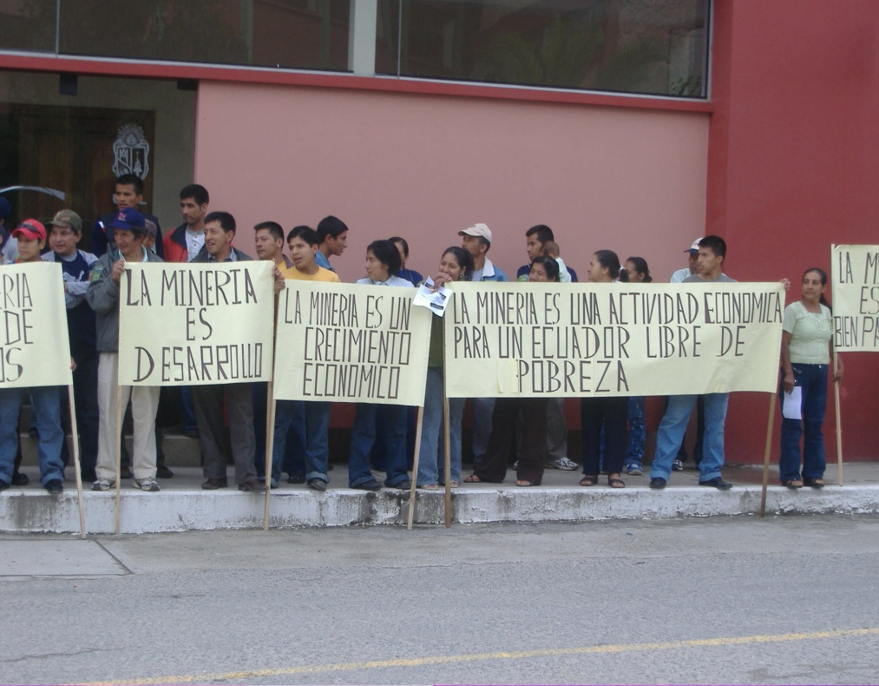
Opportunity
National investors
Employment and regional/local enterprises
Infrastructure and services
Community funds (>$200million, Michiquillay)
Fiscal and royalty transfers: large and unequal
  Bolivia 2008: Tarija produced 70% of Bolivia’s natural gas and received 35% of the entire decentralized budget in Bolivia
  Peru 2012: 0.003% of all municipalities receive 12.6% of all fiscal transfers generated by mining

Slide 36
Mobilizations, exclusions and (more?) inclusion
Counter-movements
“Another development”
Post-extractivism
Territory and autonomy
Environment and rights
Intersections with already existing movements
  Indigenous
  Afro-descendent
  Peasant
  Human rights
  Socialisms
  Guerrilla
  ….
  “our territories are being permanently affected by natural resource extraction activities and infrastructure construction …. No argument can justify government authorities or representatives of state or private companies simply ignoring all the rights that have been gained by indigenous peoples and that constitute the essence of the process of change underway in our country” (CCGT, 2010).

Slide 37
Rent-seeking movements
Opportunity and rent-seeking seeking struggles over:
Employment
Service contracts
Fiscal and royalty transfers
  Tacna vs. Moquegua, Peru 2009
  Municipal mayors and employment based clientelism
  Gran Chaco vs. Tarija, Bolivia: revenue and autonomy

Slide 38
Counter-movements within the State: environment and rights based
Ombudsman’s offices (Peru, Bolivia, El Salvador)
E.g. Defensoría del Pueblo, Peru
Ministries of Environment (El Salvador, Peru ….)
Some sub-national governments
Constitutional courts

Slide 39
….. and creating space for inclusion?
Project level re-governing:
  Stalled projects and redesigned projects (with inclusion)
Ecological and economic zoning and land-use planning
  Subnational authorities and participation
  Resistances ……
Evidence of significant changes in national governance of extraction?
  FPIC: elements in Bolivia, Ecuador, Perú (but with much opposition)
  Environmental regulation in Peru?
  Proposed legislation in El Salvador
Regulatory changes?
  Tilly and Polanyi in América Latina?

Slide 40
Returning to the reframed question…..
How inclusive and in what ways?
Do exclusions accompany the inclusions - 1?
  Social investment, social protection, “rights” advanced on the national scale (how else to presidential explain popularity?)
  Weakened territorial claims, exposure, rights weakened (how else to explain growing localized conflict?)
Do exclusions accompany the inclusions - 2?
  Interesting governance shifts, centralizing tendencies
  Exclusions of regional government
Do these exclusions de-legitimize the inclusions?
  What implications for democracy?
  Which rights count? Which rights get traded off? who decides?
  What place for decentralization within democracy?

Slide 41
Is inclusion only a matter of assets and flows?
  Efforts to include “other” visions and goals: territory; no-go areas; post-extraction; Yasuní; ZEE-OT
Are the inclusions events, or on-going processes?
  Consulta previa….
    Agreements always unravel
    CPLI as event
    CPLI as process
    CPLI as platform for participatory adaptive planning?
  Yasuní
    Yasuní as event
    Expansion of frontier of extraction as process
How do institutions for inclusion emerge?

